Slide 1
FluId Power Systems
BY Dr. OMARI MASHI KHALFAN
MEVLANA UNIVERSITY, MECHANICAL ENGINEERING DEPT.

Slide 2
HEAT GENERATION AND DISSIPATION
In hydraulic system, heat is among the most effective causes of system failure and malfunctioning.
It should be noted that whenever there is pressure drop in a hydraulic system and no mechanical work is done, then heat is generated in the system.
Among components that cause heat generation in hydraulic system are:
Pressure relief valve
Pressure reducing valve
Counterbalance valve
Flow control valves
Pumps and motors

Slide 3
HEAT GENERATION AND DISSIPATION
Pressure drops also occur in long pipes and fittings ; however if suitable lengths are selected, then pressure drops and consequent heat generation is reduced.
Other causes of heat generation include:
1. Use of small diameter pipes for higher oil flow rates
2. Poor design of hydraulic reservoir (i.e. small tank with poor air circulation)
Whenever the heat generated exceeds the rate of heat dissipation then the system will overheat.
In such cases, a heat exchanger should be incorporated to cool down the system. Heat exchangers are of two types
Shelled tube heat exchangers (water or oil cooled)
Finned tube heat exchangers (air cooled)

Slide 4
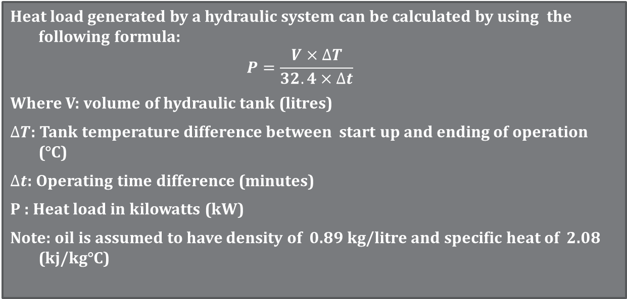
HEAT GENERATION AND DISSIPATION
Heat load generated by a hydraulic system can be calculated by using the following formula:
$$P=\frac{V×∆T}{32.4×∆t}$$
Where V: volume of hydraulic tank (litres)
$∆T$: Tank temperature difference between start up and ending of operation (°C)
$∆t$: Operating time difference (minutes)
P : Heat load in kilowatts (kW)
Note: oil is assumed to have density of 0.89 kg/litre and specific heat of 2.08 (kj/kg°C)

Slide 5
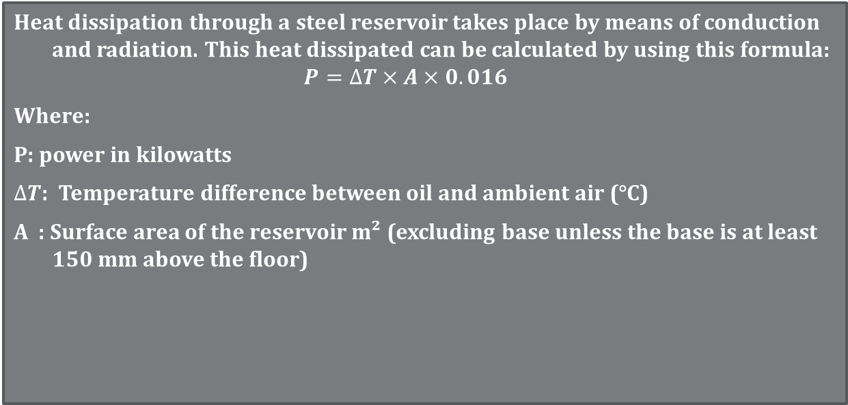
HEAT GENERATION AND DISSIPATION
Heat dissipation through a steel reservoir takes place by means of conduction and radiation. This heat dissipated can be calculated by using this formula:
$$P=∆T×A×0.016$$
Where:
P: power in kilowatts
$∆T$: Temperature difference between oil and ambient air (°C)
A : Surface area of the reservoir m² (excluding base unless the base is at least 150 mm above the floor)

Slide 6
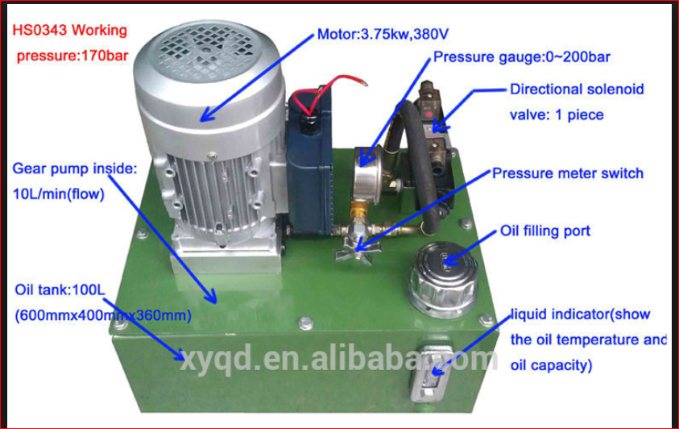
HYDRAULIC POWER UNIT

Slide 7
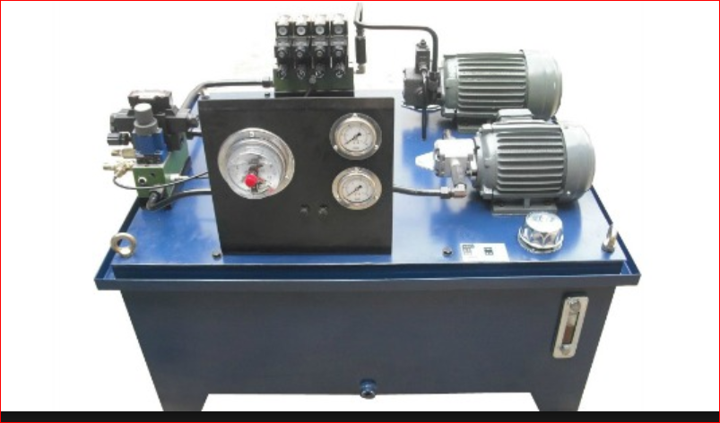

Slide 8
Proportional and servo valves
Proportional and servo valves are two types of directional control valves having continuously variable electrical modulation.
They are used to control the direction and speed of oil flows and hence actuators based on the amount of electrical signals given to the valves.
It is therefore clear that the spools within these valves slide in proportional to the voltage signals supplied to the solenoids.
Proportional valves generally have spool`s centre overlap of more than 3% and less expensive as compared to servo valves which have centre overlap of lower than 3% ; more accurate; embedded with sophisticated electronics and also much expensive.

Slide 9
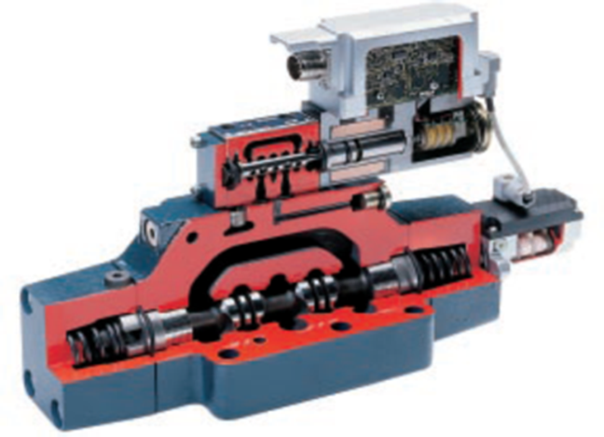
Proportional valve cross section

Slide 10
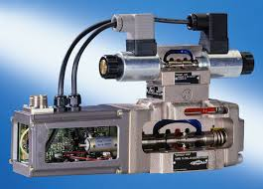
Servo valve cross section

Slide 11
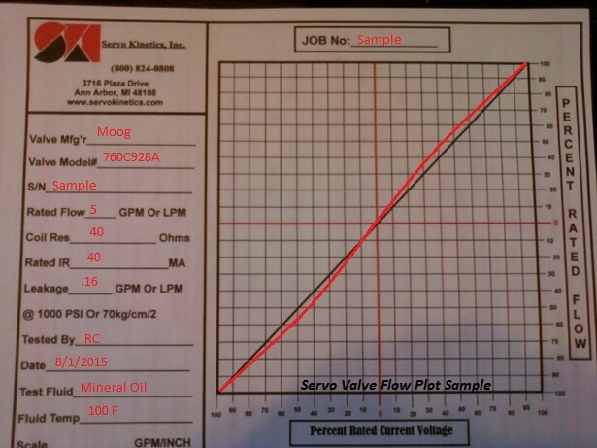
Servo Valve hysteresis

Slide 12
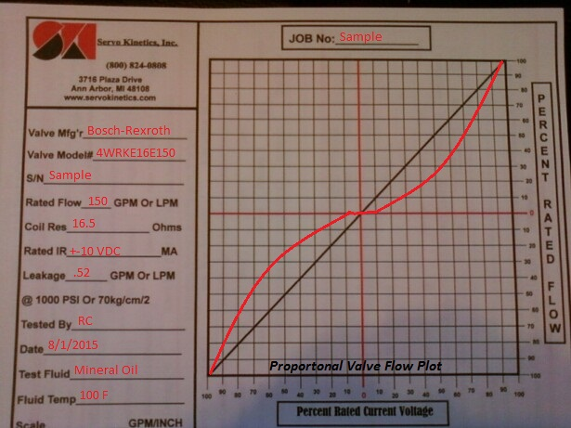
Proportional valve hysteresis

Slide 13
PROPORTIONAL VALVE SYMBOL

